Slide 1
PathFinder – A website compiling various colleges pathways
Anthony Sy (VC1A)
ANTHONY.SY50@bcmail.cuny.edu
Supervisor: Minh Le, MINH.LE@brooklyn.cuny.edu

Slide 2
Abstract
When entering a college, you can look at their official website to find information about their various pathways. For this project, I aim to compile all this information into one condensed database & website.
Completion of this project requires designing a user friendly & intuitive website, along with a working database connection.
The goal for this website is to create a single website where you can search for any desired college/university and find some that you might not even heard of, allowing the user to expand their choices.

Slide 3
Use Case
The user will come into the page with the intent of looking at various colleges/universities.
They will search by county to find all their local schools.
After selecting a school, they are brought to a page with their respective given pathways
This gives them the option to select which one they are interested in.
After clicking on the pathway they want, it will send them to a new page.
The new page will have an embedded image of the pathway as well as a directory to the original location of the information.

Slide 4
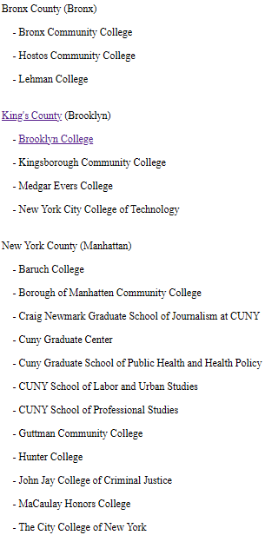
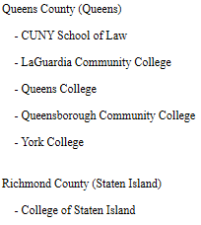
Down scaling of the project
Originally this project was aimed to encompass all counties around the states and compiling all their respective colleges & universities.
However, due to time constraint & not enough prior knowledge. The scope has severely tunneled into CUNYs specifically.
This does not mean that the scope will remain static. As I progress through deeper into the project, the scope will slowly expand.

Slide 5
User engagement
With such a compilation of pathways and courses, you would want to suggestions, advice or guidance on said selection.
I plan to add a user engaged comment & suggestion section where they can post their own opinions, thoughts, likes, dislikes, etc, that can be freely viewed by others.
However, this implementation is aimed to be an afterthought as it is something that can only be implemented after the website is finished. Thus it will most likely not be added within the semester.

Slide 6

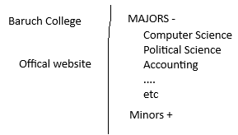
Website Interface
This is the base design of the website.
The initial page will have a search bar that allows the user to either search by county, or school name
When a school has been selected, it will show the pathways listed by Majors and Minors.

Slide 7
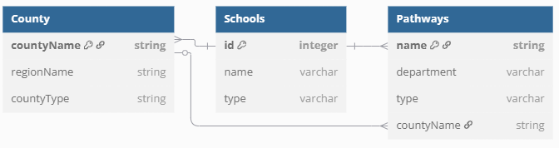
Database Schema
The expected schema structure of the database. It will contain multiple instances of schools as that is the college/universities class. The main page, will be able to connect directly to both Counties and Schools.
One County can have multiple Schools, but one School belongs to one County.

Slide 8
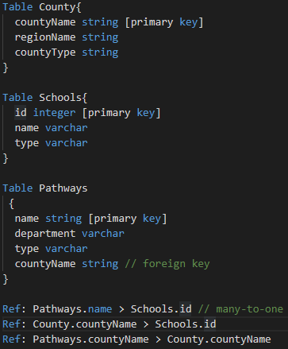
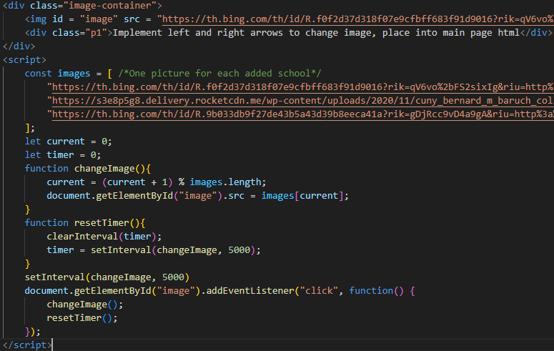
Code Snippets
Database
HTML

Slide 9
Data sources used so far
CUNYs
Brooklyn College
KingsBorough Community College
Baruch College
….
Depending on how much time is spent and left, more will be used.

Slide 10
Tools used for project
IDE for website creation – Visual Studio Code
Using TailWind extension library
DB – Django
Using SQLite
Data scraper - Scrapy
Microsoft Excel
Used for holding data
Note: These tools are subjected to change

Slide 11
CISC 3171
This class that I am currently taking, is focused on the development of android applications. However, in the process of learning it, it has taught my SMART, MVP, User Stories, etc, allowing me to create objectives and organize them easier as well.
As a user,
I want to search my local colleges,
So that I can go to their websites within 5 minutes.
S – Allowing the user to search through the schools in their area
M – The user can go to their wanted school’s website within 5 minutes
A – This can be completed in an agile iteration
R – Allowing the user to see all their local schools
T – To be completed by end of May 2025

Slide 12
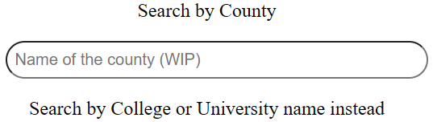
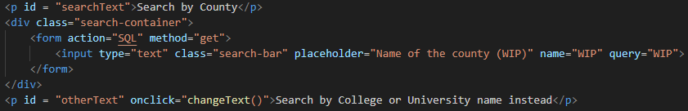
CISC 3810
This class taught database, in the form of Oracle. This is going to help me develop my back-end for my own website, which will use SQL, as they both have similar syntax language.
I aim to use this database as a query, allowing the user to search for their wanted county, college or university.
As of 3/27, I am currently researching on how to connect the database into the html.

Slide 13
Biggest obstacles experienced so far
Throughout the project, I am relearning HTML as I learned it in High School. Thus I am coding along as I go. However, despite learning about both HTML and databases separately, I didn’t learn how to integrate databases into anything, causing me to be stumped.
So far I’ve had a lot of help from my supervisor as he gave me a lot of usage examples of backend, which includes
Django
FastAPI
Flask
I have done some research on these frameworks, allowing me to see how the connection between the front and back-end works.

Slide 14
Planned Progression Schedule
As of updating this PowerPoint, it is week 10, 4/6/25
Week 4-8
Relearn HTML, CSS. Create base website & learn JavaScript
Week 8-11
Create database & connect it with website, bell and whistles
Week 12-14
Post project on public threads, get user reactions & comments.(Potentially)
Data Scrap for scoped information. (Priority)
Week 14-16
Final bug fixes & adjustments
Final Submission on 5/12
Schedule is subjected to change as progression happens

Slide 15
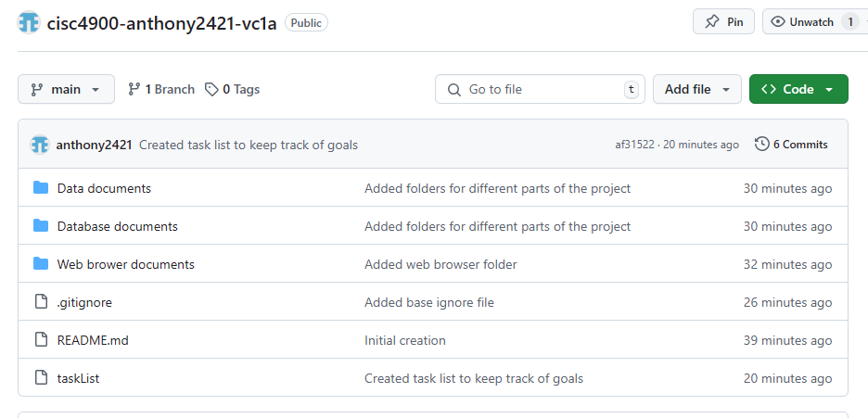
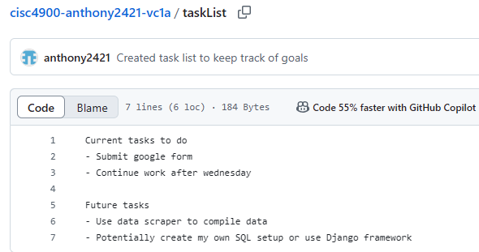
GitHub Repository
Original Repository
https://github.com/anthony2421?tab=repositories
Project Management
cisc4900-anthony2421-vc1a/taskList at main · anthony2421/cisc4900-anthony2421-vc1a

